Slide 1
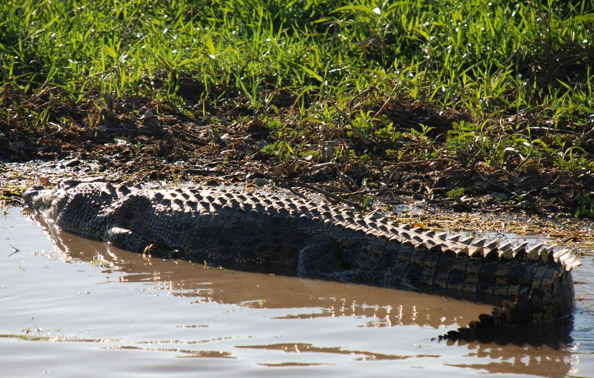
What do we know about Metals and Radionuclides coming from the Ranger Mine??
Alligator Rivers Region, Australia
Preston Phillips, Scott Braley, Chloe Stenkamp-Strahm
ERHS 535, Fall 2016

Slide 2
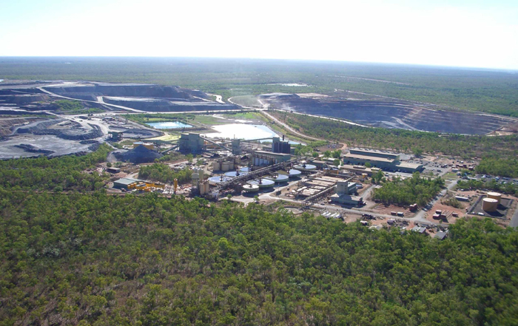
Ranger Uranium Mine, operational from 1980 - present

Slide 3
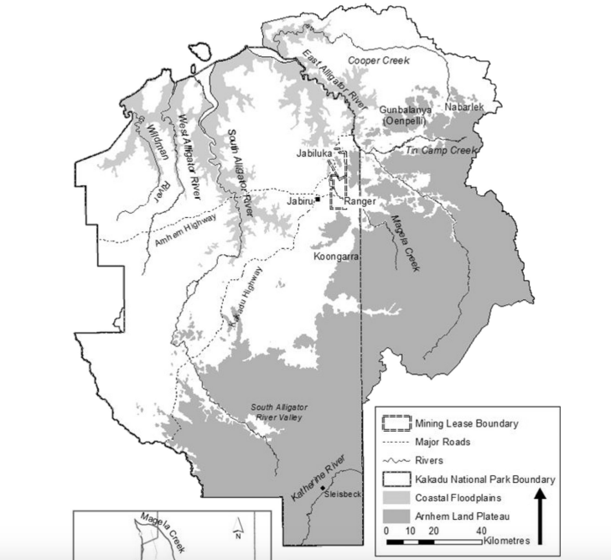
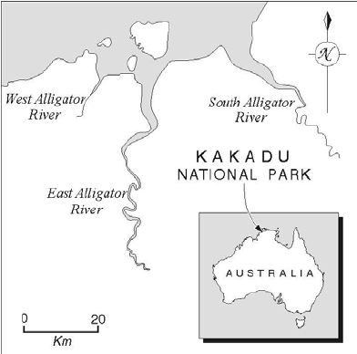
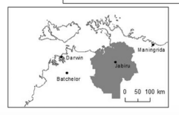
Alligator Rivers Region
Doering and Boellhofer, 2016

Slide 4
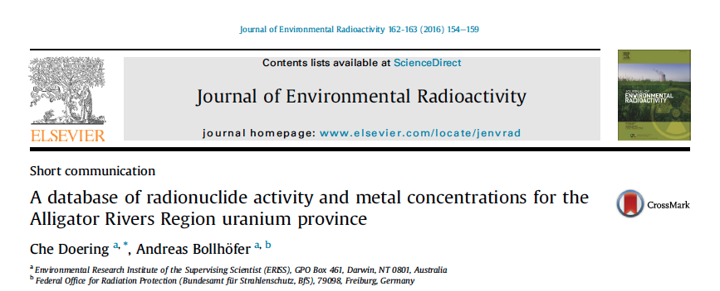
‘Environmental Research Institute of the Supervising Scientist’

Slide 5
Why do we want to look at animal/environmental radionuclide and metal concentrations in the region?
Impacts on Kakadu National Park (1/3 of land is park)
Overall impacts of uranium mining on water and fauna (2/3 of land is aboriginal owned)
Concerns about contamination of bush foods, contamination of flora for wild animal consumption
Notes:
Mining is slated to cease in 2021, with remediation done by 2026 so the land can be incorporated into the national park
Edible tissues of wild plants and animals that are traditionally hunted by and gathered by aboriginal people for sustenance

Slide 6
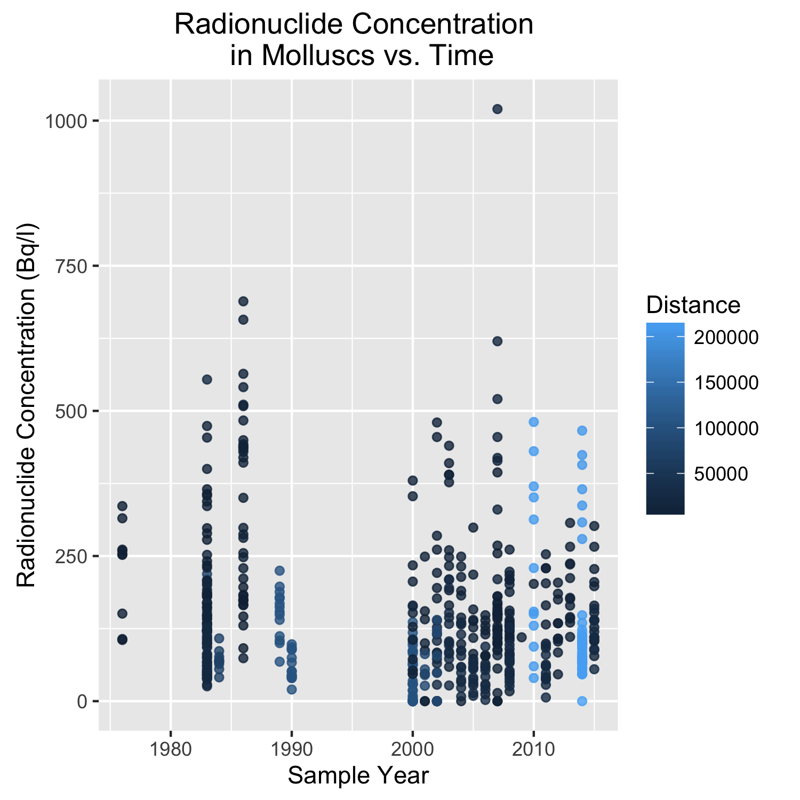
There is some evidence for pre- and post- mining change…...

Slide 7
What have we chosen to look at in this data set??
Sample types:
Terrestrial Animals
Freshwater Animals
Terrestrial Plants
Freshwater Plants
Terrestrial Soil
Freshwater Sediment
Mollusc
Fish
Water
Date: 11/2/1976 to 11/30/2015
Location: Distance (km) from the mine
Measurements:
Metals: Cu, As, Pb, Hg
Radionuclides (summed):
U238
U234 Th230
Ra226
Pb210
Po210 Th232
Ra228
Th228
Ac227
K40
Notes:
Radionuclides can sum (and given reasoning)
Selected these 4 metals because we know that they have specific disease outcomes in large mammals, and can bioaccumulate

Slide 8
What questions have we decided to ask?
Overarching: Has the Ranger Mine contaminated the surrounding Alligators River Region with radionuclides and metals?
Specifically:
Where are the sample types of interest located in relation to the mine?
How does the concentration of radionuclides and metals change with distance from the mine?

Slide 9
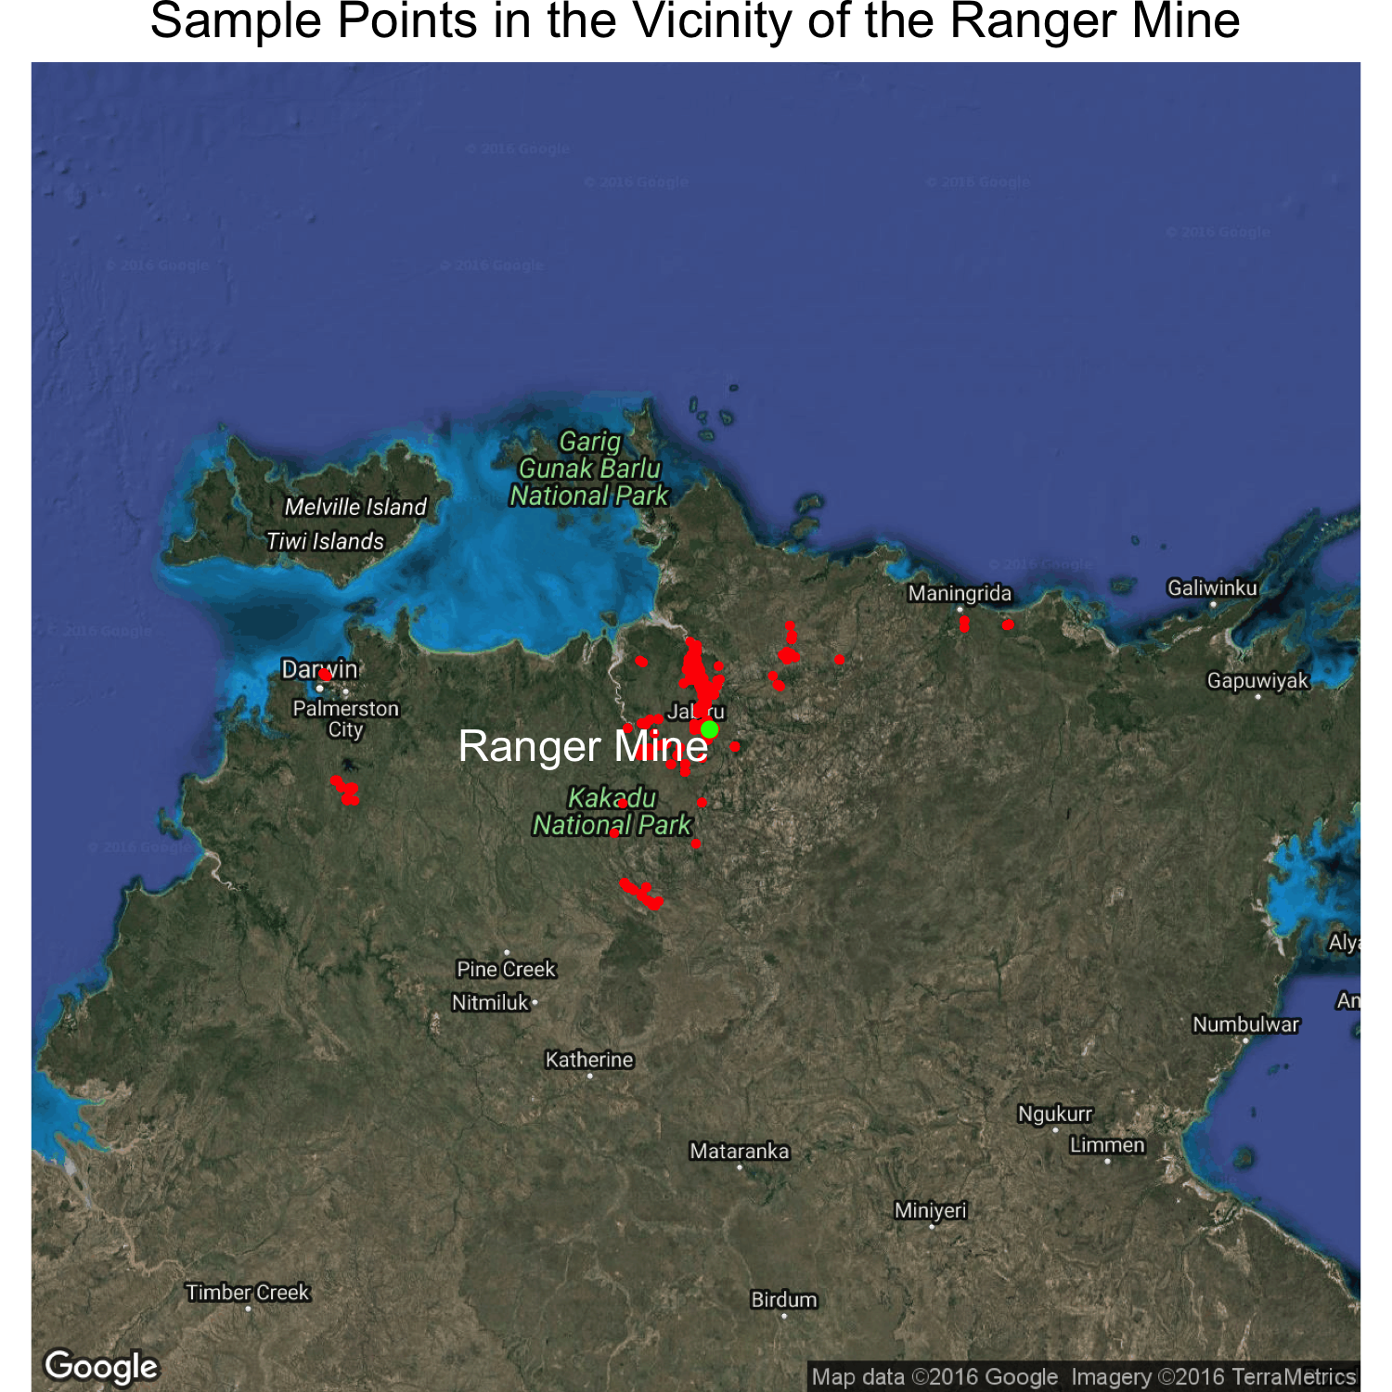
Where are the sample types of interest located in relation to the mine?

Slide 10
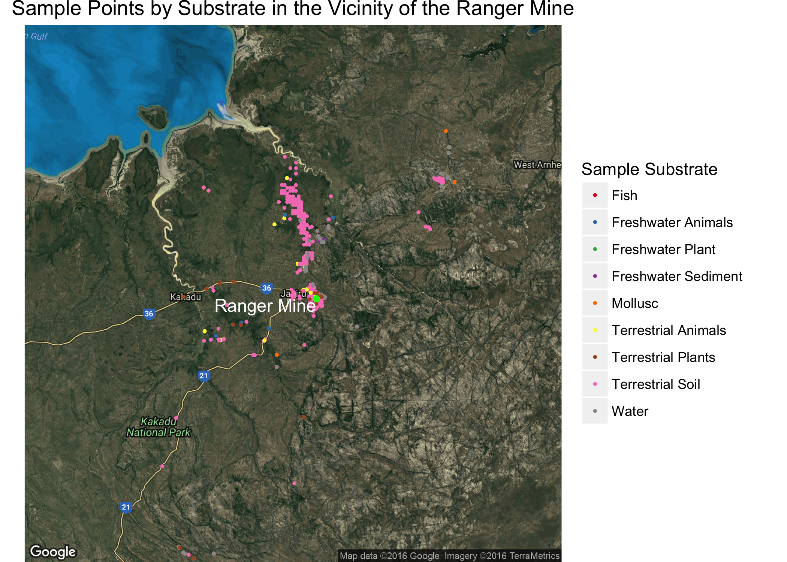
Where are the sample types of interest located in relation to the mine?

Slide 11
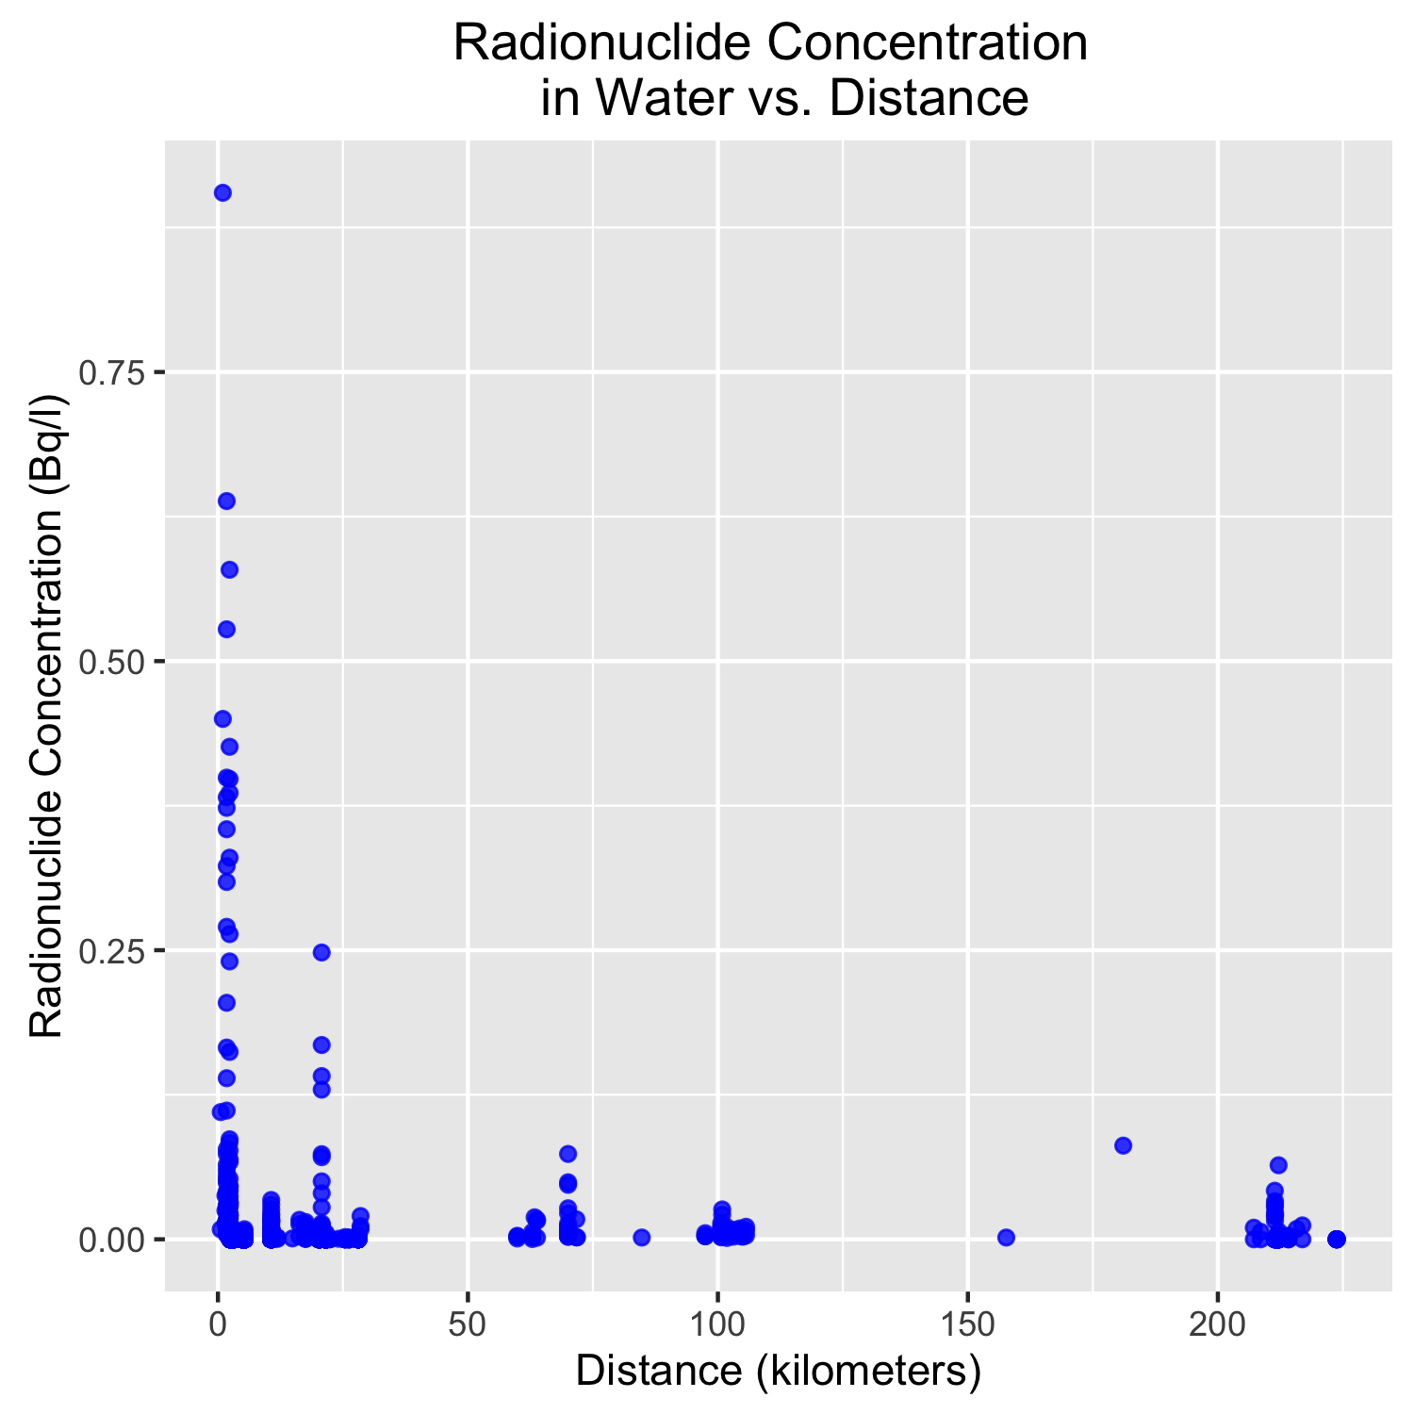
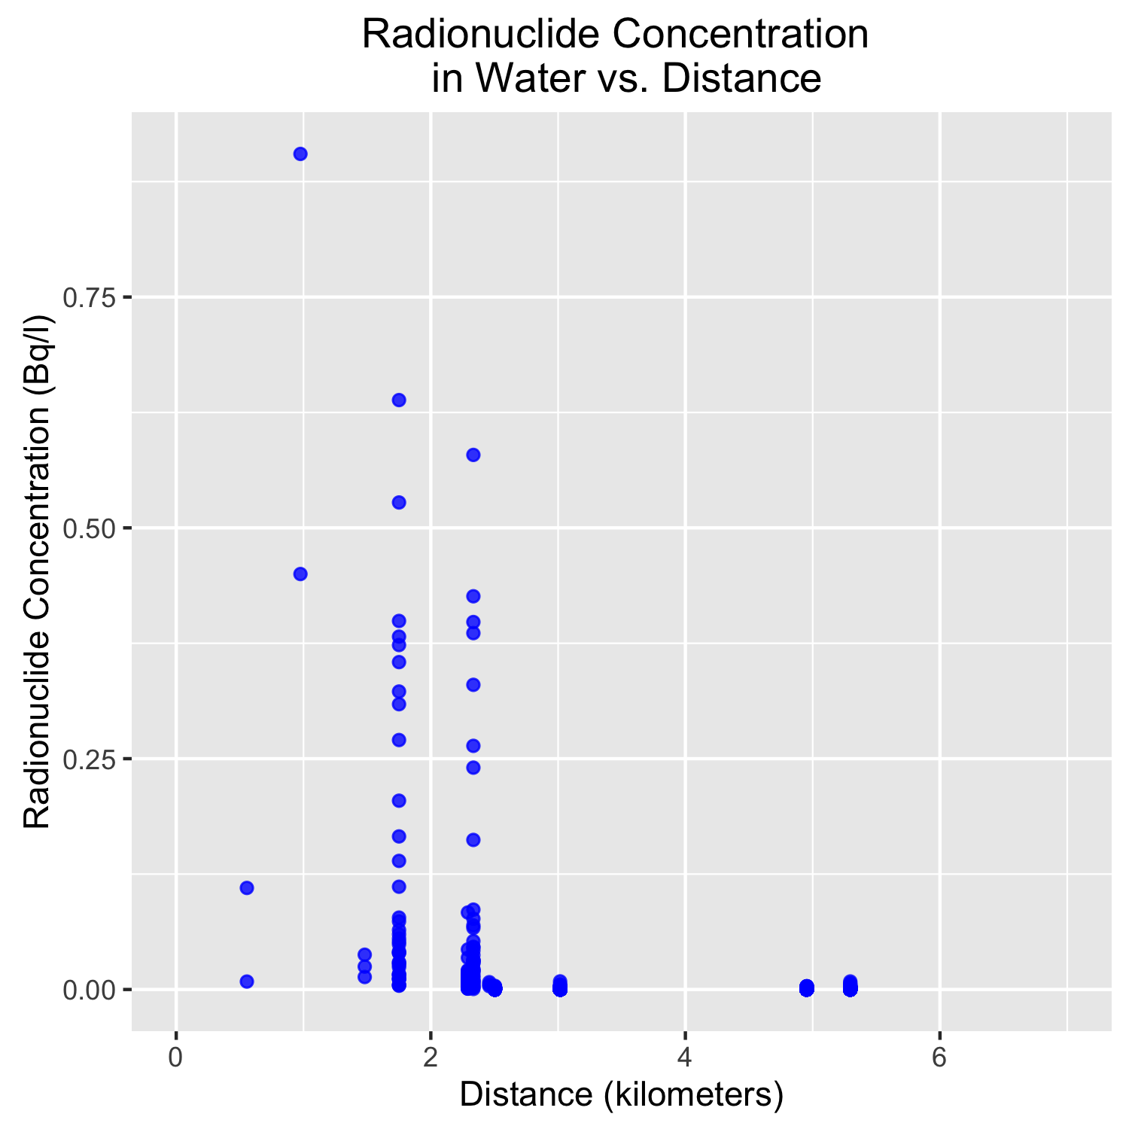
How does the concentration of radionuclides change with distance from the mine?
Notes:
Before I go into the graph, I will explain how we determined the distance from the mine. Ideally, we would have liked to have distance downriver as well as distance from the water source. We did not have enough time to write an algorithm as the mapping task proved very time intensive. We decided that an appropriate unit of distance would be distance as the crow flies from the mine.
There is an evident decrease in radionuclide concentrations as a function of distance. But outside of 30 km away from the mine, the radionuclide concentrations appear to be near background.

Slide 12
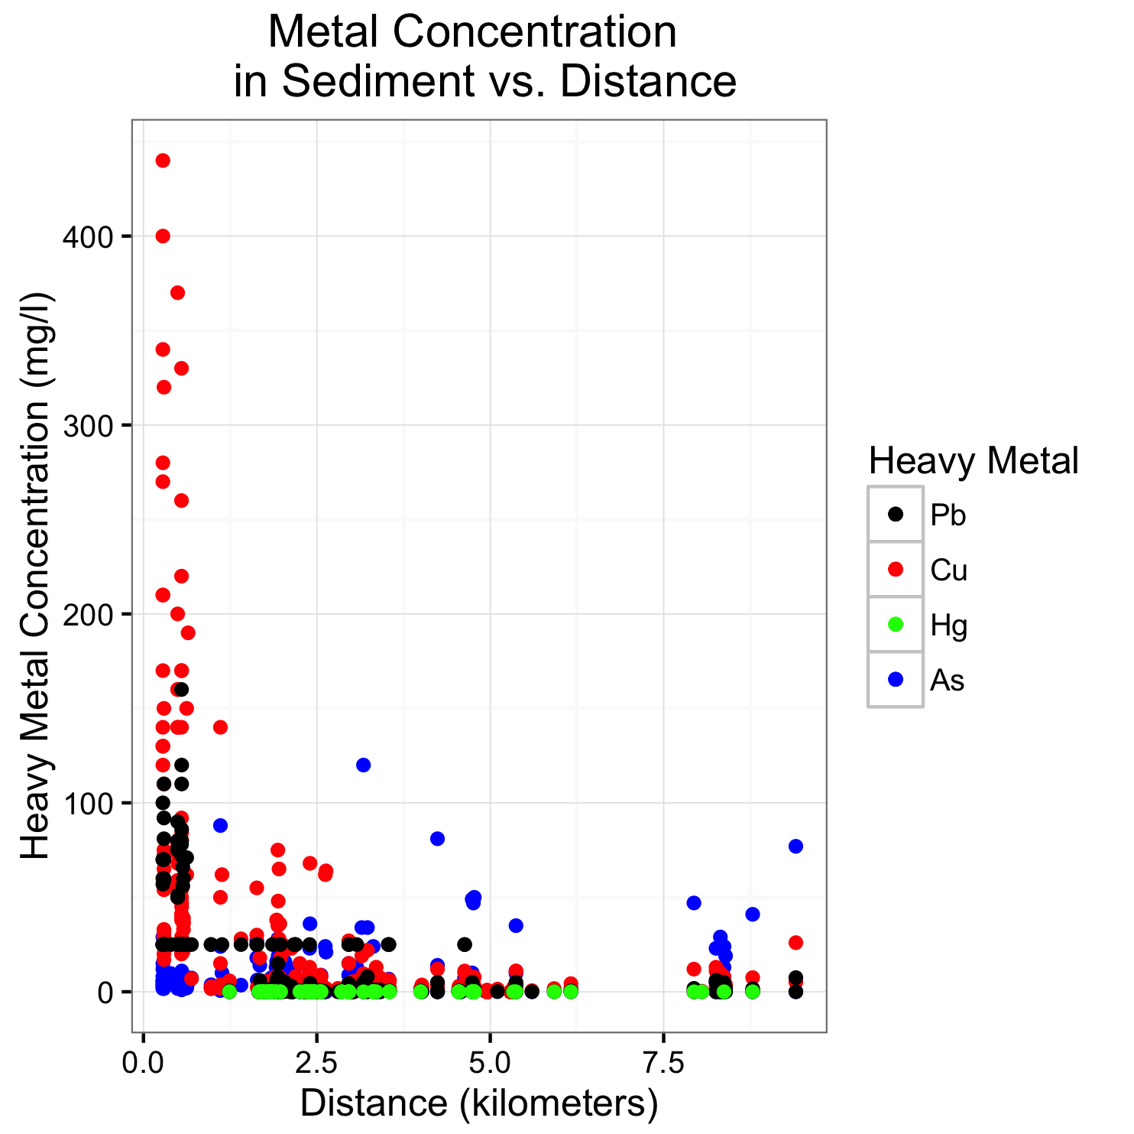
How does the concentration of metals change with distance from the mine?
Notes:
The graph shown illustrates the concentrations (mg/l) of Lead, Copper, Arsenic and Mercury as a function of distance. The dots in red represent Copper. This is a perfect example of what we would expect if heavy metals were being released into the environment from the mine. Without knowing the local geology, it can only be inferred that the mine is contributing to higher levels of copper in the river sediment.
We can also see that lead follows a similar trend. The concentrations of lead are significantly elevated within a 2-kilometer radius from the mine. We can see that there is then a flat across many distance. This is the lower limit of detection for the particular measurement method. There could be multiple measurement methods used over years leading to the other sample points below the “line”.
There could be a potential non-linear correlation for Arsenic. There are not enough data points above background for any significant statistics.
Finally, we have mercury in green.

Slide 13
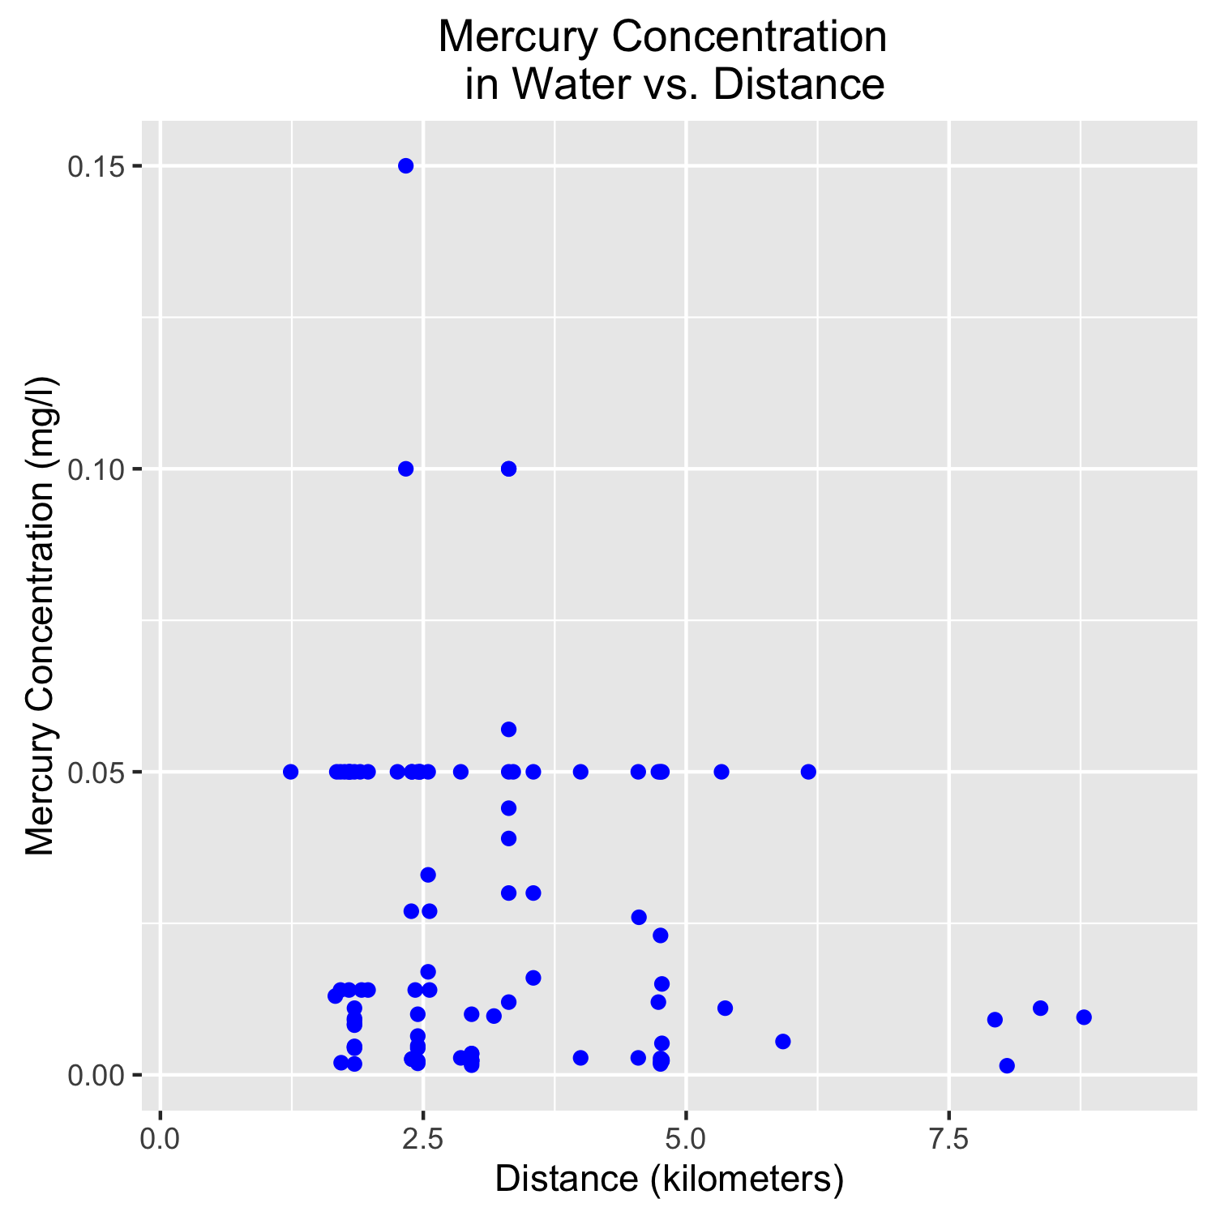
How does the concentration of metals change with distance from the mine?
Notes:
If we plot the mercury concentration on a separate plot. All of the values appear to be near or below a certain limit of detection.

Slide 14
Now we can look at sample type, distance, time, and concentration of contaminant together
SHINY!!!!!

Slide 15
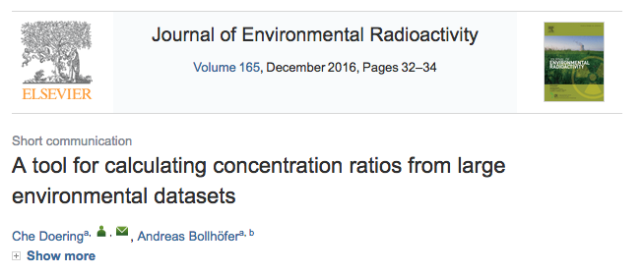
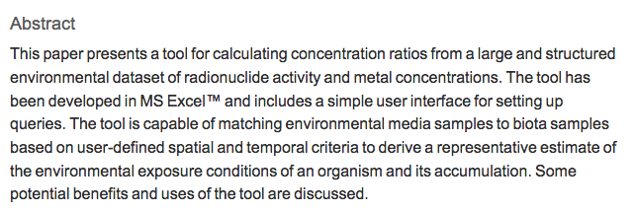
Conclusions
There do seem to be trends in radionuclide and metal concentrations with proximity to the mine.
As far as we know, this is the first time this data set of contaminants has been analyzed over time and related to their distance from the mine
…....We’d expect others to start analyzing distance and time, especially because the concentration measurements now have validation methods!
Notes:
the original paper just showed histograms of sample numbers over the years
another paper discussed how do measure concentrations- this wasn’t something available to us to use as it was just published this december!

Slide 16
Our Approach and Lessons Learned in R

Slide 17
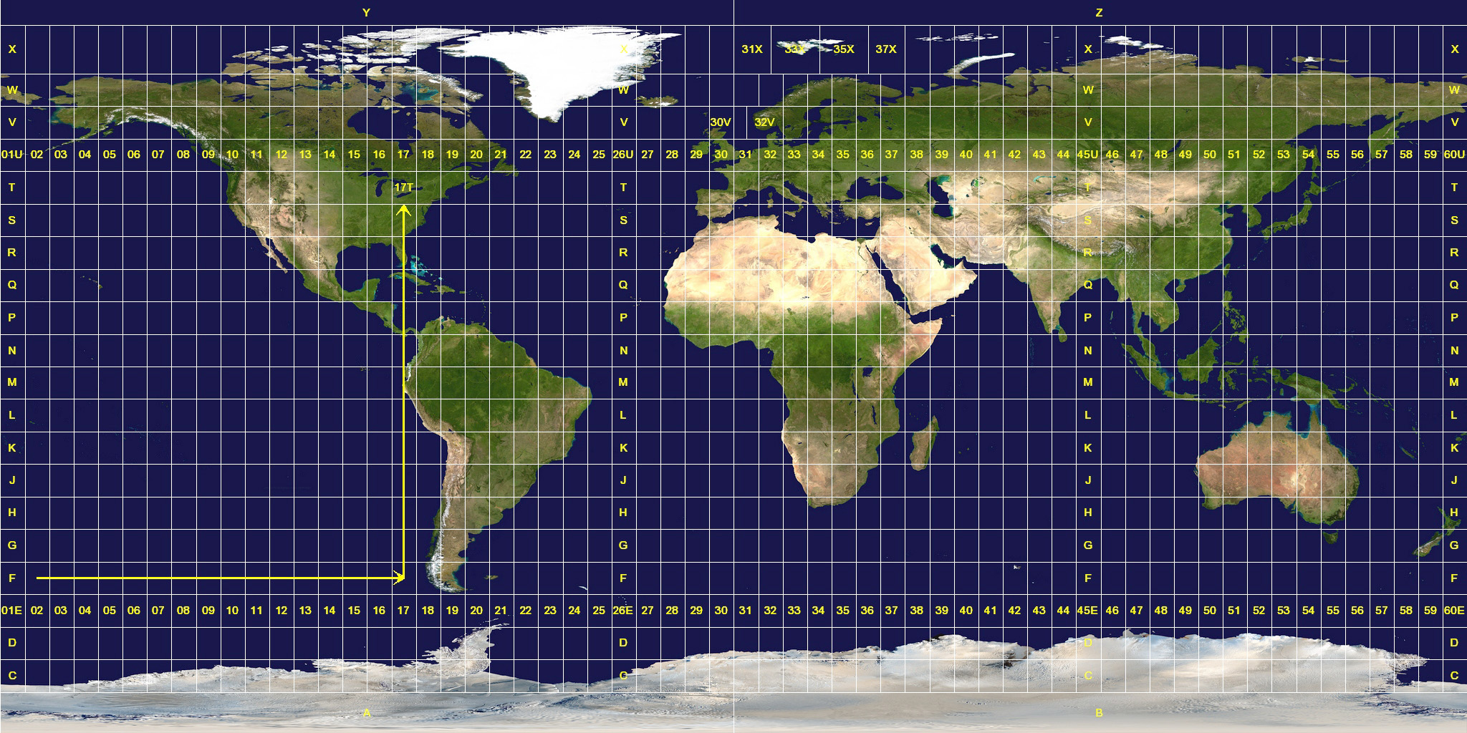
Geospatial Data
Basic shape of the world (sphere vs. oblate ellipsoid)
Which projection?
Mercator, cylindrical, conic (how do you go from 3D to 2D?)
Reference points (where is zero?)
How is location measured (meters, degrees, kilometers)
Our data is in UTM (a Mercator Projection), in zones 52S and 53S, and uses Easting and Northing (meters from a given point in the zone) instead of Latitude and Longitude, and uses a standard called WGS84 to define the shape of the earth.

Slide 18
R and Geospatial Data
Packages rgdal and sp are two of the packages available for R to manipulate and convert geospatial data.
To convert the data to lat-long for plotting required several steps.
Extract and split data from Zone 52S and 53S
Convert from data frame to Spatial Points Dataframe
Tag the coordinate system for each zone - Zone 52S data is EPSG 32752, and Zone 53S is EPSG 32753 (these are international standard codes)
Once the dataframes are set up, the tranform is done to convert the original coordinates to EPSG 4326, which is standard lat-long format.
Rejoin the new lat-long data with the original data frame.
geo_data_53 <- subset(geo_data, zone == "53S")
coords_53 <- cbind(
Easting = as.numeric(as.character(geo_data_53$easting)),
Northing =as.numeric(as.character(geo_data_53$northing)))
spatial_52 <- SpatialPointsDataFrame(coords_52, data =
data.frame(geo_data_52$entry_num),
proj4string = CRS("+init=epsg:32752"))
spatial_52_ll <- spTransform(spatial_52,
CRS("+init=epsg:4326"))

Slide 19
case_when, a cleaner if-then-else
While working on this project, I ran up against what was going to be a very messy ifelse statement and went looking for alternatives
I found the case_when statement.
Usage
Implementation
case_when(
logical_statement1 ~ desired_outcome1,
logical_statement2 ~ desired_outcome2,
TRUE ~ default_outcome
)
Pseudocode
if x1 then y1
elseif x2 then y2
else y3
clean_aussie_data <- clean_aussie_data %>%
mutate(sample_type = case_when(
clean_aussie_data$wildlife_group == "Terrestrial-Bird" ~ "Terrestrial Animals",
clean_aussie_data$wildlife_group == "Terrestrial-Reptile" ~ "Terrestrial Animals",
clean_aussie_data$wildlife_group == "Terrestrial-Mammal" ~ "Terrestrial Animals",
clean_aussie_data$wildlife_group == "Terrestrial-Grasses and Herbs" ~ "Terrestrial Plants",
clean_aussie_data$wildlife_group == "Terrestrial-Plant" ~ "Terrestrial Plants",
clean_aussie_data$wildlife_group == "Terrestrial-Soil" ~ "Terrestrial Soil",
clean_aussie_data$wildlife_group == "Freshwater-Bird" ~ "Freshwater Animals",
clean_aussie_data$wildlife_group == "Freshwater-Reptile" ~ "Freshwater Animals",
clean_aussie_data$wildlife_group == "Freshwater-Fish" ~ "Fish",
clean_aussie_data$wildlife_group == "Freshwater-Mollusc" ~ "Mollusc",
clean_aussie_data$wildlife_group == "Freshwater-Sediment" ~ "Freshwater Sediment",
clean_aussie_data$wildlife_group == "Freshwater-Vascular Plant" ~ "Freshwater Plant",
clean_aussie_data$wildlife_group == "Freshwater-Water" ~ "Water",
TRUE ~ "NA"))

Slide 20
R and Shapefiles
3 types of shapefiles:
Polygon
Chain
Point
Files within a shapefile
.shp: geometry for the data (polygons, points…)
.prj: projection used (UTM, Long-Lat)
.dbf: data associated with each line, point, polygon
.shx: index file for the .shp geometry
Works without defining the extension
rivershape<-readShapeLines("River Data/AUS_water_lines_dcw", proj4string=CRS("+proj=longlat"))
rivermouthshape<-readShapePoly("River Data/AUS_water_areas_dcw.shp", proj4string=CRS("+proj=longlat")))

Slide 21
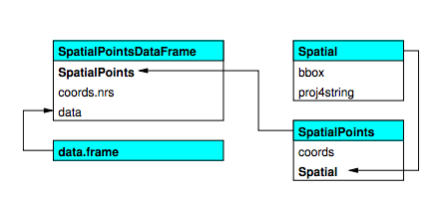
Filtering Shape Files
The spatial points data frame that is produced can be filtered using the str_detect function
The spatial data points data frame where the “slots” are similar to the elements of a list
river_map<-rivershape[str_detect(rivershape@data$NAM, "ALLIGATOR"), ]

Slide 22
Approach and Lessons with Shiny
Inserting an image in ui.R (in a folder labeled ‘www’):
fluidRow(
column(6,
img(src = "Ranger2005.jpg", height = 100, width = 375),
h6("Image of Ranger Treatment plant, with mine
pit (source www.world-nuclear.org)"),
Making the pop-ups for user defined samples, containing concentrations, in server.R:
popups <- reactive({
paste0("<b>Copper:</b> ",
filteredData()$Cu, "<br/>",
"<b>Arsenic:</b> ",
filteredData()$As, "<br/>",
"<b>Mercury:</b> ",
filteredData()$Hg, "<br/>",
"<b>Lead:</b> ",
filteredData()$Pb, "<br/>",
"<b>Radionuclides:</b> ",
filteredData()$radionuclides)
Notes:
used the standard approach for shiny, but inlcuded image. made sure that specified fluid row and column. main package used was leaflet

Slide 23
Approach and Lessons with Shiny
Making a leaflet map in the server. R script:
output$RiverMap <- renderLeaflet({
leaflet(geo_aussie_shiny) %>%
addProviderTiles("Stamen.Watercolor")%>%
setView(132.9107, -12.6848, zoom = 7) %>%
addPolylines(data=river_map)%>%
addPolylines(data=river_mouthmap)
})
Keeping the output map ‘panned’ when the user changes selections:
observeEvent({
input$Substrate
input$slider1
}, {
leafletProxy("RiverMap", data = filteredData()) %>%
clearMarkers() %>%
addMarkers(data = filteredData(), lat = ~ Latitude, lng = ~ Longitude,
popup = popups())
Notes:
because leaflet is able to look out our geo aussie data set and pull out the long and lat, and make a map right away! as long as we’ve previously subsetted the data set in the server.R script to include what users had specified in the app (ie the year and the sample type). now in this call its not the subsetted data, because we needed that in the next few lines of code to keep the map panned correctly-
the leaflet map is very touchy for when the user changes their selections in the app, and actually takes a ton of time to go bac and re-generate the map. so can keep it panned to one place via the ‘observeEvent’ function in the server.R script

Slide 24
Questions?

